Slide 1
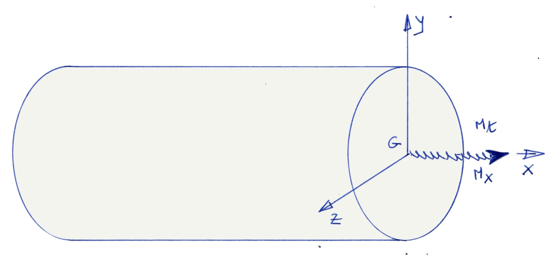
Twisting Moment
Twisting Moment - CAUC- 2011

Slide 2
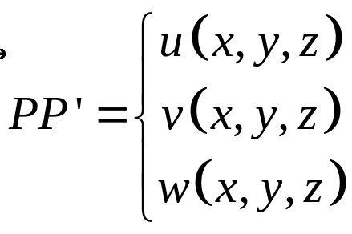
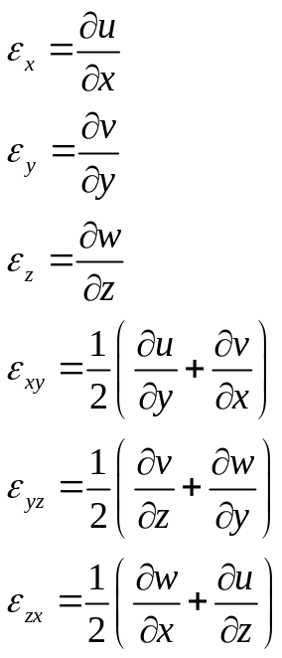
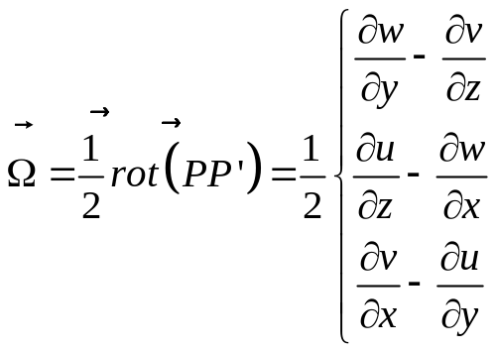
Remumber what we need !
Twisting Moment - CAUC- 2011

Slide 3
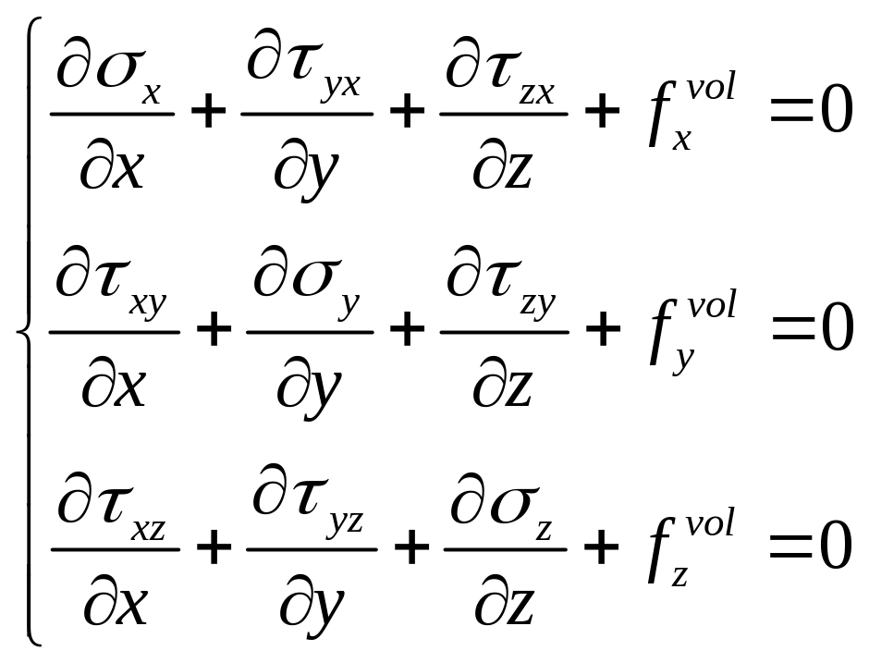
Equilibrium’s Equation
Twisting Moment - CAUC- 2011

Slide 4
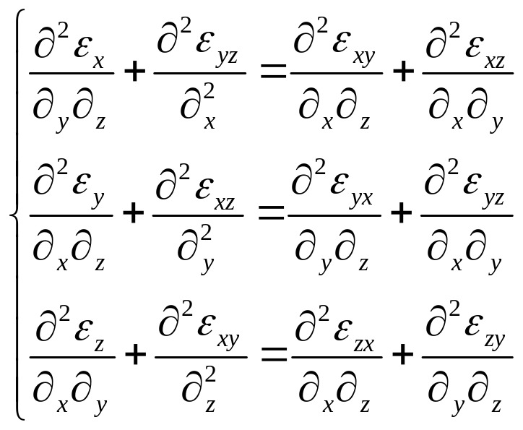
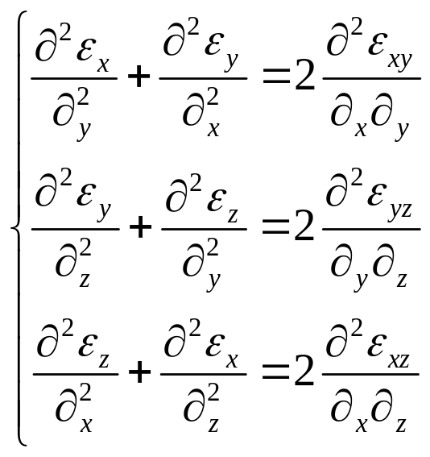
Equation for Compatibility
Twisting Moment - CAUC- 2011

Slide 5
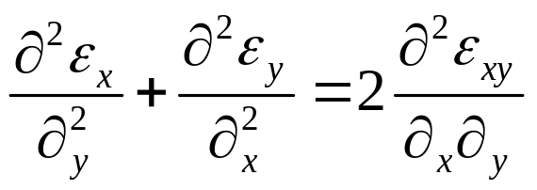
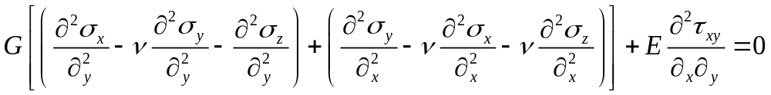
Equation for Compatibility
Remark : The equations of compatibility are derivatives of the second order with respect of x,y, z, in terms of :
Strains,
Stresses.
Twisting Moment - CAUC- 2011

Slide 6
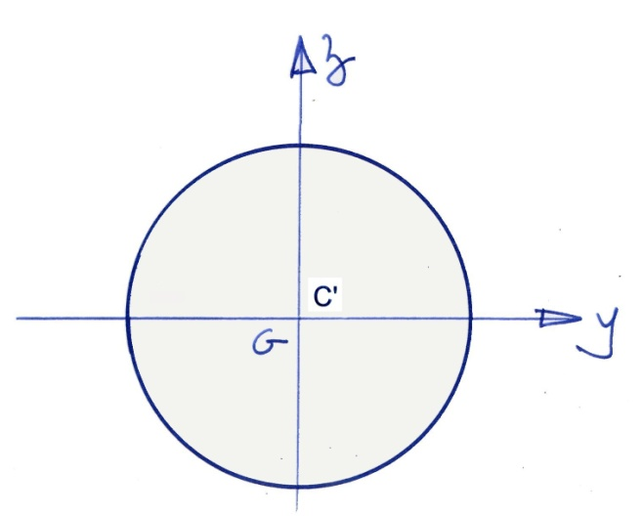
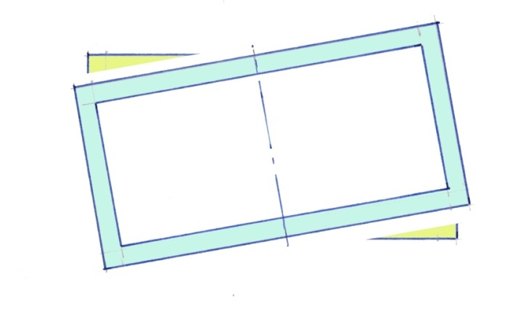
Twisting Center
The twisting moment will be applied in a point C’ such as the displacement of the cross section will be a rotation around the axis C’X
Twisting Moment - CAUC- 2011

Slide 7
Elastic solution
This solution is due to M. Barré de Saint Venant
Adhémar, Jean-Claude Barré de Saint-Venant, born in 1797 at Villiers-en-Bière (Seine-et-Marne) and died in 1886 at Saint-Ouen (Loir-et-Cher), is a famous French engineer, physicist and mathematician.
Twisting Moment - CAUC- 2011

Slide 8
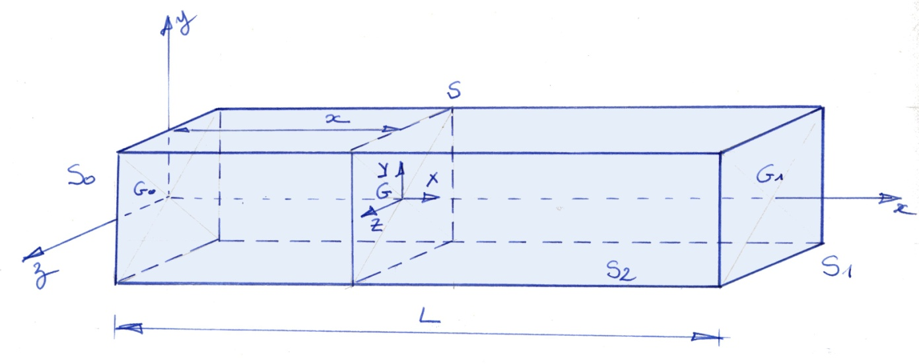
Elastic solution
Twisting Moment - CAUC- 2011

Slide 9
Description of the beam and load
Geometry :
Constant section S
Straight line for the middle curve,
Load
A load in applied on S0 and S1, such as the resultant is a pure torque
  * Mt on the point C0
  * -Mt on the point C1
Twisting Moment - CAUC- 2011

Slide 10
Elastic solution
The solution must verify :
- The equilibium equations
- The boundary conditions,
- The compatibility equations,
- The Hook’s Law, relationship between stress and strains
Twisting Moment - CAUC- 2011

Slide 11
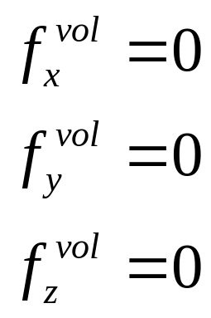
Equilibrium’s Equation
The volumic forces will be neglected
Twisting Moment - CAUC- 2011

Slide 12
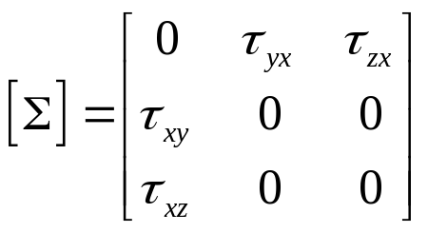
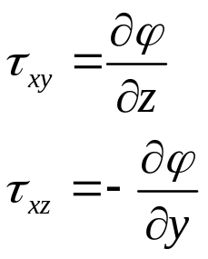
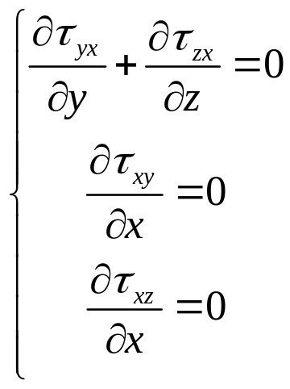

Elastic solution : Equilibrium
Assumption on the stresses
The first equation is verified
The second and third equations
are such that the shear stresses don’t depend of x
Equilibrium
Twisting Moment - CAUC- 2011

Slide 13
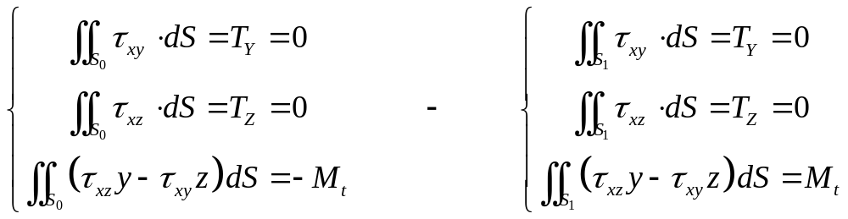
Elastic solution :
BC’s on S0 ans S1
On the boundary S0
On the boundary S1
Twisting Moment - CAUC- 2011

Slide 14
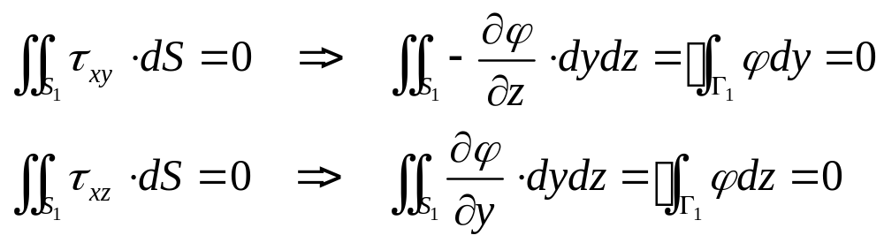
BC’s on S1
on S1
Twisting Moment - CAUC- 2011

Slide 15
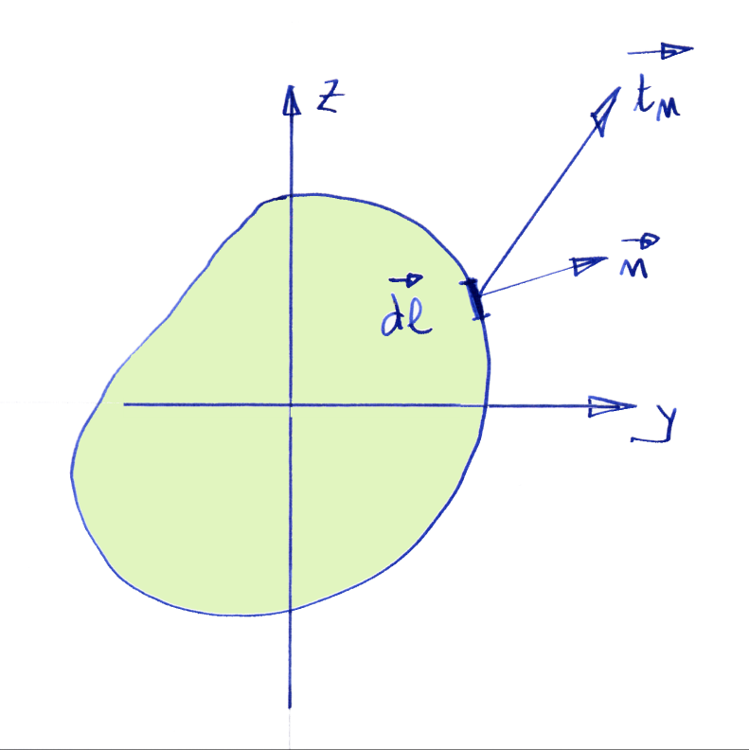
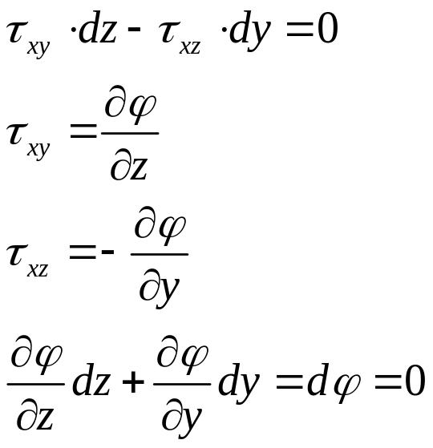


Elastic solution :
Boundary Conditions on Lateral Free Surface
The function must have a constant value on the curve
Twisting Moment - CAUC- 2011

Slide 16
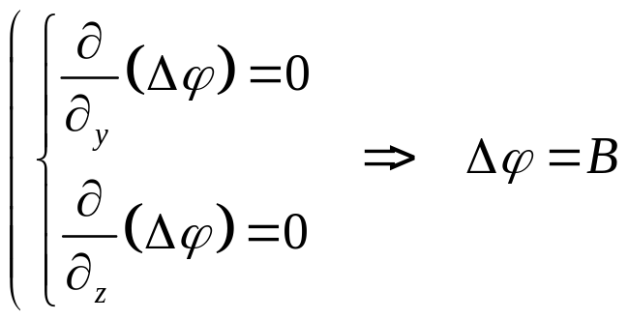
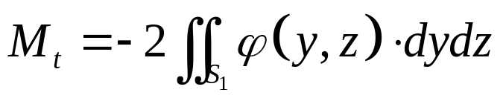
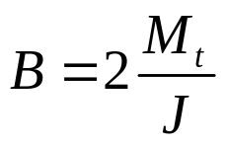
Equation for Compatibility
The compatibility equations are reduced to
But
Remark : the dimension of J is the same that the one of a quadratic moment (length to the fourth)
We can write
Twisting Moment - CAUC- 2011

Slide 17
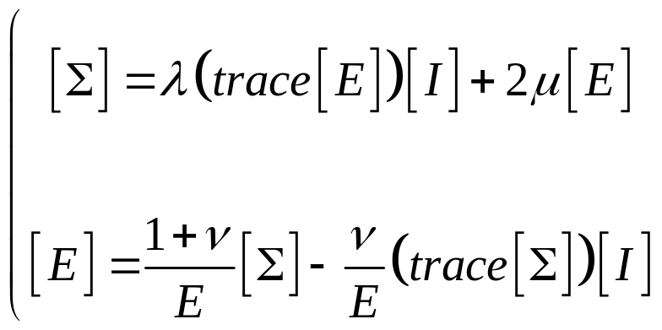
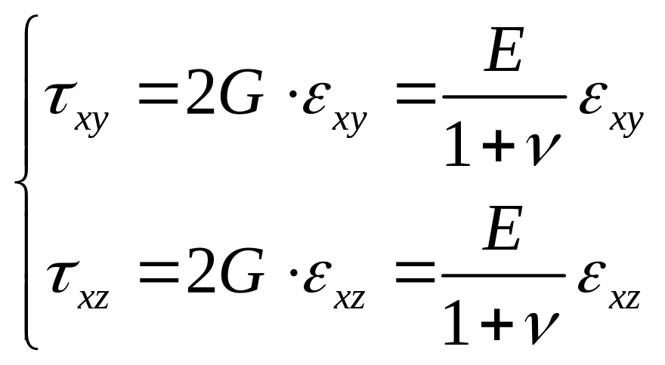
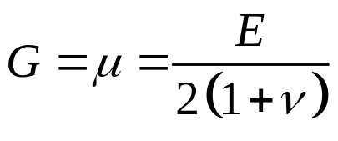
Relationship Stress/ Strain
Twisting Moment - CAUC- 2011

Slide 18
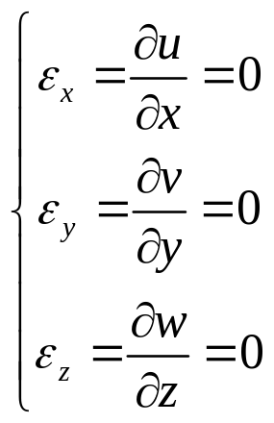
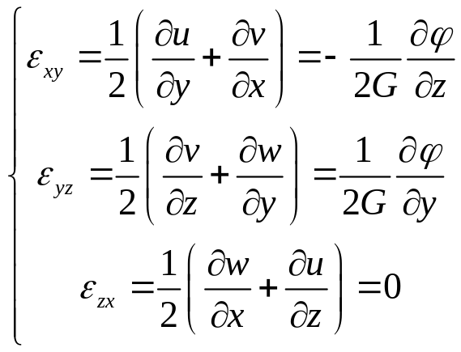
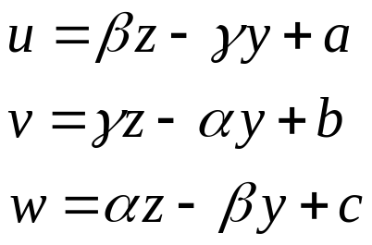
Elastic solution
Displacements
The general solution of this set of differential equations, without the second member, is
Twisting Moment - CAUC- 2011

Slide 19
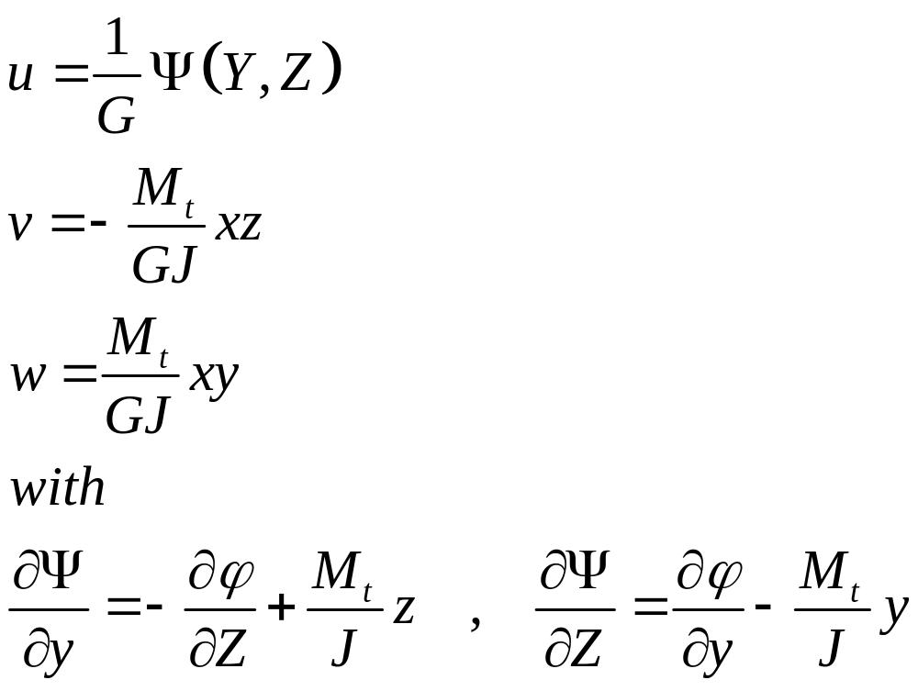
Elastic solution
Displacements
The particular solution of this set of differential equations, with the second member, is
Twisting Moment - CAUC- 2011

Slide 20
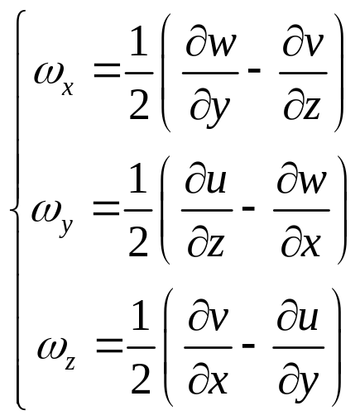
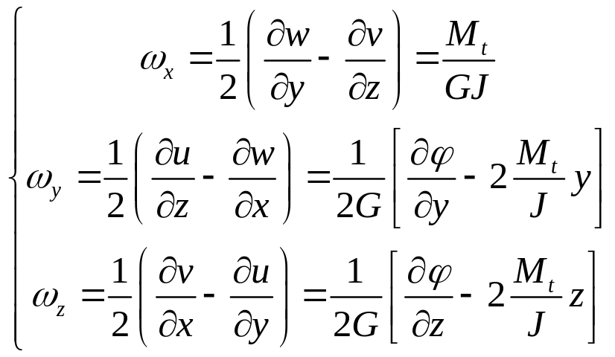
Elastic solution : Rotation
Twisting Moment - CAUC- 2011

Slide 21
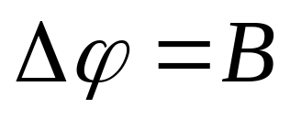
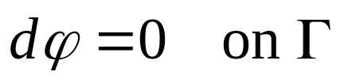
Elastic solution
Process 1
Find a function such as :
The Laplacian of this function is equal to a constant B
The twisting moment is equal to :
The differentiel of the function is equal to zero on the boundary of the cross section
Twisting Moment - CAUC- 2011

Slide 22

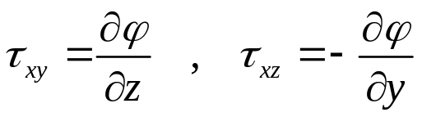

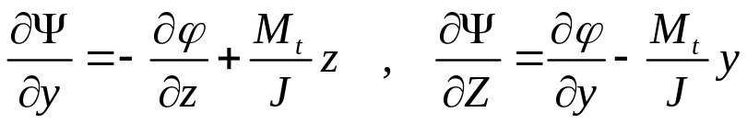
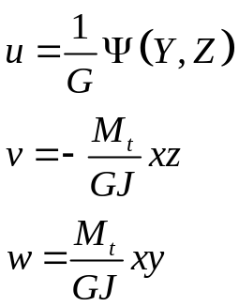

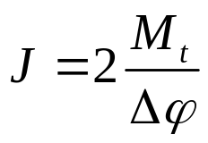
Elastic solution : Process 2
When the function is defined :
The stresses are equal to
The warping function is defined by integration of the equations :
The field of displacement :
The field for rotation is :
The constant J is :
Twisting Moment - CAUC- 2011

Slide 23
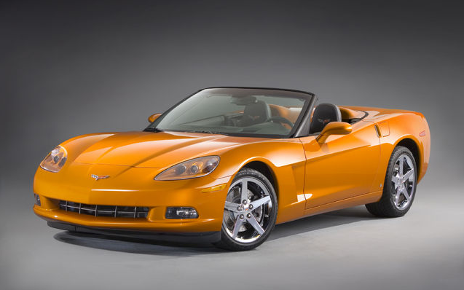
Elastic solution : Cylindrical beam
The cylindrical beam is a very important case, because very often used as transmission shaft for power
Horse power : 300
Rotation speed : 3000 tr/mn
Twisting Moment - CAUC- 2011

Slide 24

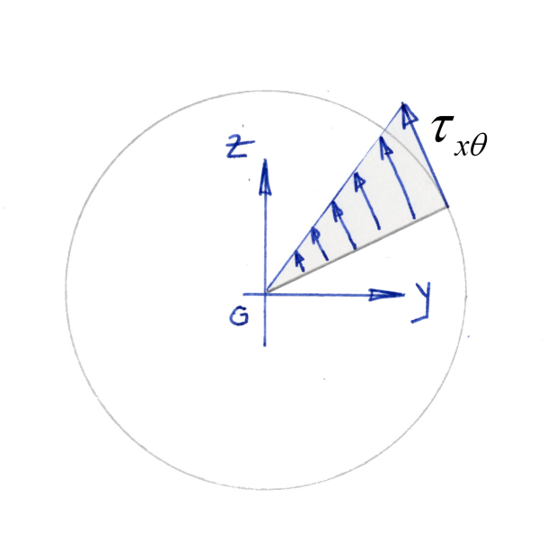
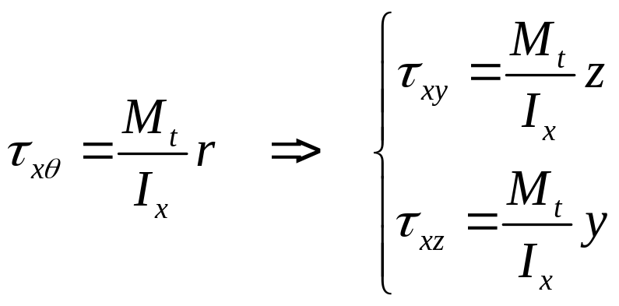

Elastic solution : Cylindrical beam
Twisting Moment - CAUC- 2011

Slide 25
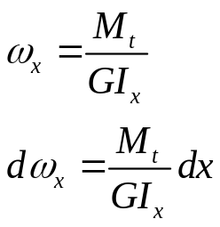
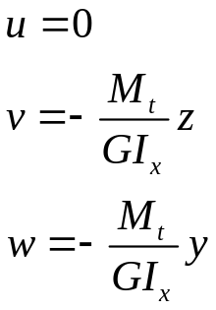
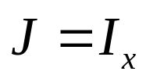
Elastic solution : Cylindrical beam
The cross section has no warping displacement : The cross section stays flat after the load is applied
The displacement of a cross section is a global rotation around the x axis
The components of the displacement vector are :
Twisting Moment - CAUC- 2011

Slide 26
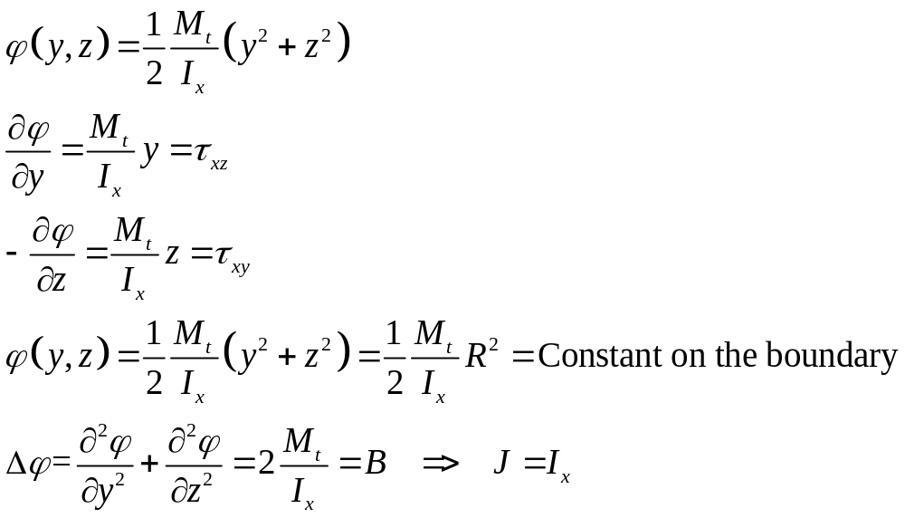
Elastic solution : Cylindrical beam
Verification of the Saint Venant’s Solution
Twisting Moment - CAUC- 2011

Slide 27
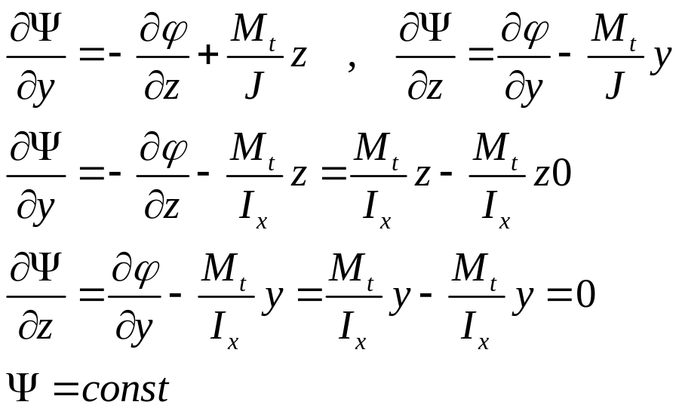
Elastic solution : Cylindrical beam
Verification of the Saint Venant’s Solution
Twisting Moment - CAUC- 2011

Slide 28
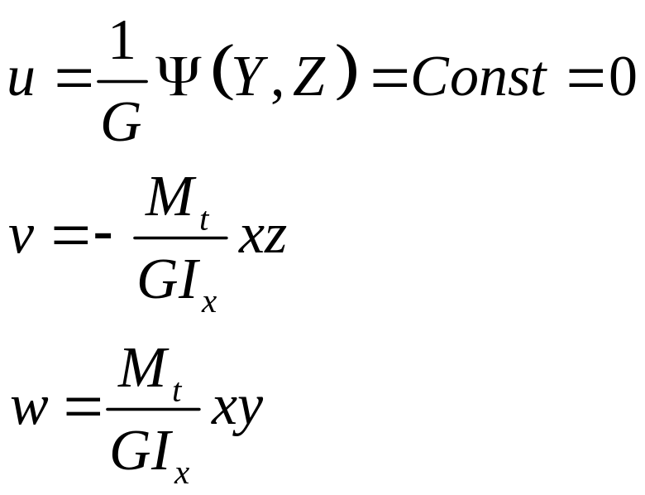
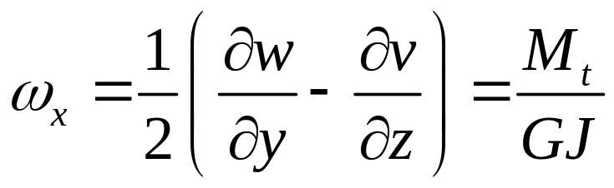
Elastic solution : Cylindrical beam
Verification of the Saint Venant’s Solution
Twisting Moment - CAUC- 2011

Slide 29
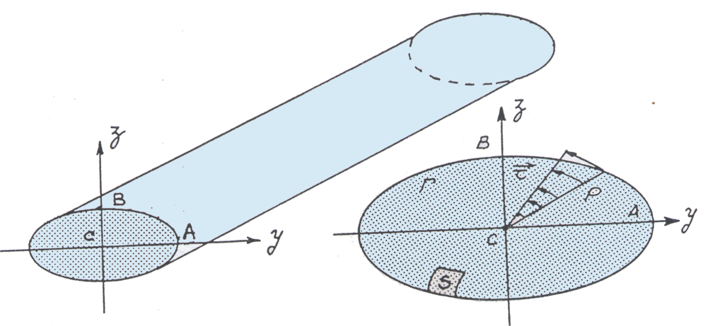
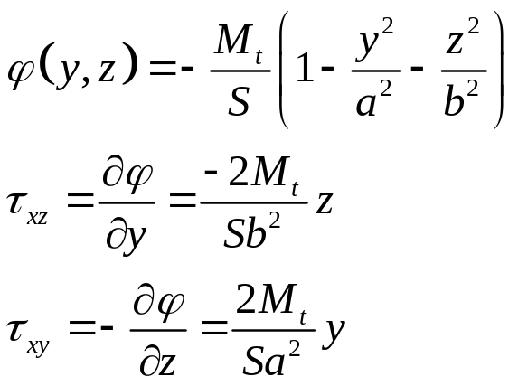
Elastic solution : Exemple 1
Twisting Moment - CAUC- 2011

Slide 30


Elastic solution : Exemple 1
Remarks :
The maximum stress is in B
The stresses varies on a radius with a linear variation
If a=b=r, we find the previous results
Twisting Moment - CAUC- 2011

Slide 31


Elastic solution : Exemple 2
Equilateral triangle :
Height = 3a
G
AB
BC
CA
Twisting Moment - CAUC- 2011

Slide 32

Elastic solution : Exemple 2
Remark : The maximum stress is on the middle of each edge of the triangle
Twisting Moment - CAUC- 2011

Slide 33

Elastic solution : Exemple 3
Twisting Moment - CAUC- 2011

Slide 34


Elastic solution : Exemple 3
Twisting Moment - CAUC- 2011

Slide 35




Elastic solution : Exemple 3
Remark : The maximum stress is on the middle of the largest edge.
Remark : The important quantities are J and the maximum shear stress
 | 1 | 1.2 | 1.5 | 2 | 2.5 | 3 | 5 | 10 | 100
 | 0.141 | 0.139 | 0.131 | 0.115 | 0.098 | 0.088 | 0.058 | 0.031 | 0.003
 | 4.801 | 4.572 | 4.326 | 4.061 | 3.888 | 3.745 | 3.433 | 3.205 | 3
Twisting Moment - CAUC- 2011

Slide 36


Elastic solution : Exemple 3
Twisting Moment - CAUC- 2011

Slide 37

Assumptions for theory of beam
The cross section will stay flat after the torque is applied
The rotation of the cross section will be defined by an equation like this one :
Twisting Moment - CAUC- 2011

Slide 38

Internal energy on a slice of beam
Twisting Moment - CAUC- 2011

Slide 39
Twisting and Shearing center
Twisting Moment - CAUC- 2011

Slide 40

Thin wall structures
There are different thin wall structures :
Closed cross section with one cavity,
Closed cross section with several cavities
Opened cross section
Twisting Moment - CAUC- 2011

Slide 41

Thin wall structures
Example of a transmission shaft for power
Twisting Moment - CAUC- 2011

Slide 42
Thin wall structures : Objectives
What are the objectives :
Define the cross section
  The position of the center of gravity
  The principal axis
  The quadratic moments
Find the stresses for each point,
Find the coefficient J
Find the position of the twisting center
Twisting Moment - CAUC- 2011

Slide 43



Flow of the shear stress
Twisting Moment - CAUC- 2011

Slide 44


Thin wall structures : Exemple 2
Geometry
Twisting Moment - CAUC- 2011

Slide 45

Thin wall structures : Exemple 2
Twisting Moment - CAUC- 2011

Slide 46


Thin wall structures : Exemple 4
Twisting Moment - CAUC- 2011

Slide 47

Thin wall structures : Exemple 3
Twisting Moment - CAUC- 2011

Slide 48
Measure of a twisting moment with strain gages
Twisting Moment - CAUC- 2011

